Slide 1

Title Slide Option 1
and
Addie
Dennis

Slide 2

Title Slide Option 2
Addie
Dennis

Slide 3

Title Slide Option 3
Addie
Dennis

Slide 4


2 Images Option 2
Addie
Dennis

Slide 5


2 Images Option 3
Addie
Dennis

Slide 6

Title Slide Option 1
and
Addie
Dennis

Slide 7

Fullscreen Image Option 5
Addie
Dennis

Slide 8



3 X Images Option 2
Addie
Dennis

Slide 9




4 X Images Option 1
Addie
Dennis

Slide 10




4 X Images Option 2
Addie
Dennis

Slide 11
Active Directory & the Domain Name System
Addie
A Match Made in Heaven
Dennis
Notes:
By Jake Hildreth and Jim Sykora
A Match Made in Heaven? That’s not quite right…

Slide 12
Active Directory & the Domain Name System
Addie
A Match Made in Heave
Dennis
Notes:
By Jake Hildreth and Jim Sykora
A Match Made in Heaven? That’s not quite right…

Slide 13
Active Directory & the Domain Name System
Addie
A Match Made in Heav
Dennis
Notes:
By Jake Hildreth and Jim Sykora
A Match Made in Heaven? That’s not quite right…

Slide 14
Active Directory & the Domain Name System
Addie
A Match Made in Hea
Dennis
Notes:
By Jake Hildreth and Jim Sykora
A Match Made in Heaven? That’s not quite right…

Slide 15
Active Directory & the Domain Name System
Addie
A Match Made in He
Dennis
Notes:
By Jake Hildreth and Jim Sykora
A Match Made in Heaven? That’s not quite right…

Slide 16
Active Directory & the Domain Name System
Addie
A Match Made in Hel
Dennis
Notes:
By Jake Hildreth and Jim Sykora
A Match Made in Heaven? That’s not quite right…

Slide 17
Active Directory & the Domain Name System
Addie
A Match Made in Hell
Dennis
Notes:
By Jake Hildreth and Jim Sykora
A Match Made in Heaven? That’s not quite right…

Slide 18
Active Directory & the Domain Name System
Addie
A Match Made in Hel
Dennis
Notes:
By Jake Hildreth and Jim Sykora
A Match Made in Heaven? That’s not quite right…

Slide 19
Active Directory & the Domain Name System
Addie
A Match Made in He
Dennis
Notes:
By Jake Hildreth and Jim Sykora
A Match Made in Heaven? That’s not quite right…

Slide 20
Active Directory & the Domain Name System
Addie
A Match Made in Hec
Dennis
Notes:
By Jake Hildreth and Jim Sykora
A Match Made in Heaven? That’s not quite right…

Slide 21
Active Directory & the Domain Name System
Addie
A Match Made in Hec
Dennis
Notes:
By Jake Hildreth and Jim Sykora
A Match Made in Heaven? That’s not quite right…

Slide 22
Active Directory & the Domain Name System
Addie
A Match Made in Heck
Dennis
Notes:
Just right!

Slide 23

Who are we?
Jim Sykora
Long time IT generalist
Security Consultant in Identity Security
Joined Trimarc early 2022
Most active on Twitter: @JimSycurity

Slide 24
Who are we?
Jake Hildreth
Long time IT generalist
Active Directory Security Assessment Service Lead
Joined Trimarc mid-2021
Trimarc Twitch Happy Hour Co-host
Maintainer of Locksmith
Most active on… LinkedIn?
Notes:
Programming in BASIC on the C64 and Apple IIe

Slide 25
Who is Dennis?
Domain Name System (DNS)
Born in the early 80s
Provides recursive name resolution
Essential to the modern internet
It’s ALWAYS DNS
Notes:
Before DNS, one HOSTS file on all computers to provide basic name to address translation. To get listed in the HOSTS file, you’d have to call someone… on the telephone… during normal business hours.
By the early 80s, the growth of the fledgling internet called for the creation of an automated system to handle the creation and management of the system

Slide 26
Who is Addie?
Active Directory (AD)
Kerberos
Lightweight Directory Access Protocol

Slide 27
A Quick History
Pre-Windows 2000 name resolution was a mess
February 17, 2000: Windows 2000 family is released
AD + DNS = ♥ ♥ ♥
AD uses DNS for almost all the things
DNS info is stored in AD
Compromise AD to compromise DNS
Compromise DNS to compromise AD
Notes:
Before Active Directory, there was NT Directory Services (NTDS).
Many folks were using NetBIOS and WINS for name resolution at this time.
Or maybe HOSTS files. If they were even using TCP/IP and not IPX/SPX(NWLink).
But Windows NT 4.0 had Microsoft DNS server and it got some updates in Windows NT 4.0 SP3.
Windows 2000 Server was released on February 17, 2000 to replace Windows NT 4.0. Addie and Dennis have been shacked up ever since.
Active Directory Integrated DNS (ADIDNS) relies on Active Directory's multi-master replication method and directory structure for storage.
Active Directory Domain Services (AD DS) relies on DNS for name resolution for everything from clients locating a domain controller to Kerberos authentication.
The dnsNodes that AD DS relies on to locate domain controllers and services are stored in AD and generally replicated with AD.
Addie and Dennis are now co-dependent
Throw to Jim for details

Slide 28
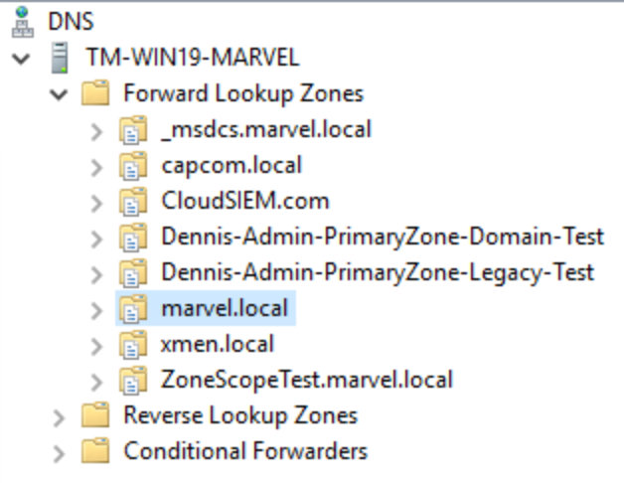
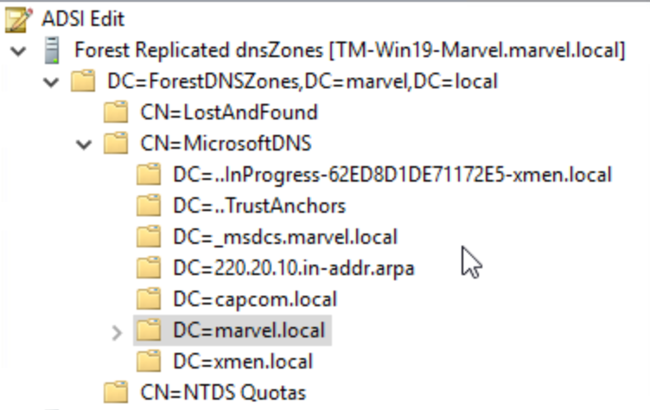
A Quick History
Pre-Windows 2000 name resolution was a mess
February 17, 2000: Windows 2000 family is released
AD + DNS = ♥ ♥ ♥
AD uses DNS for almost all the things
DNS info is stored in AD
Compromise AD to compromise DNS
Compromise DNS to compromise AD
Notes:
Traditional DNS servers might store their information in a zone file with a Start of Authority and then all the records for that zone. ADIDNS can do these local zones also, but ADIDNS stores replicated zones in AD. Like this forest replicated dnsZone.

Slide 29
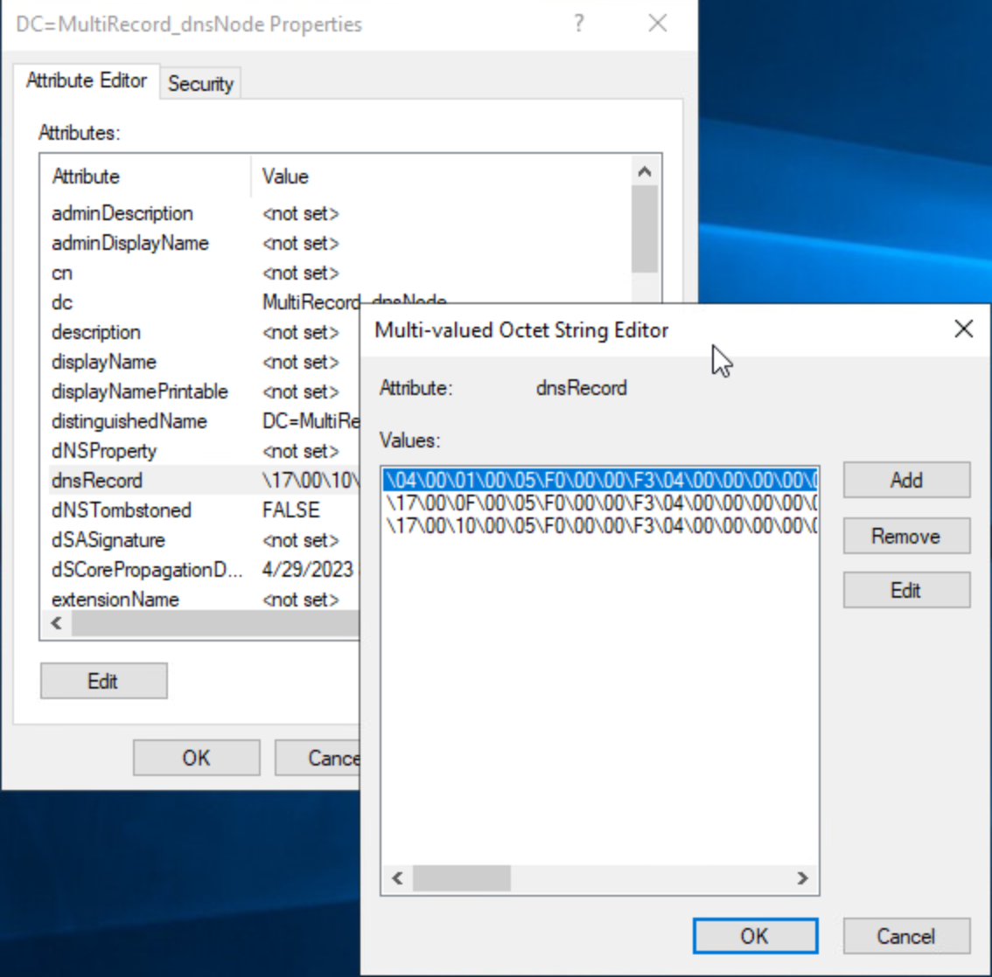
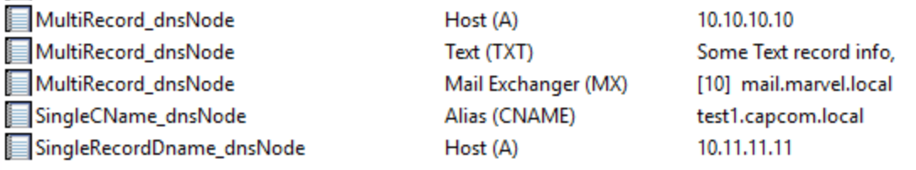
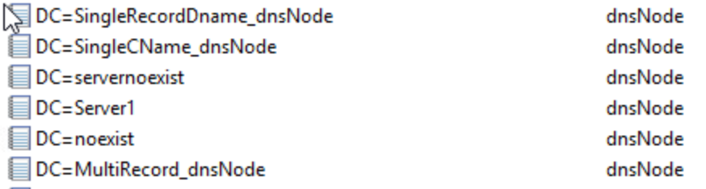
Notes:
And within each ADIDNS zone that’s stored in AD the records are stored as dnsNodes objects. Each dnsNodes object has attributes that define the record. DC, dNSProperty, dNSTombstoned, and the multi-value dnsRecord where the node/record data is stored. As we can see here a dnsNodes can have more than 1 value.
How dnsRecord properties are stored: bit arrays
https://learn.microsoft.com/en-us/openspecs/windows_protocols/ms-dnsp/6912b338-5472-4f59-b912-0edb536b6ed8
https://learn.microsoft.com/en-us/openspecs/windows_protocols/ms-dnsp/4957298c-2775-4abe-b357-bb03bc346ead

Slide 30

A Happy Marriage
Something Old
Something New
Something Borrowed
Something Blue
Notes:
We styled our talk on the classic “Something Old, Something New, Something Borrowed, Something Blue”
Old: prior art
New: new methods of abusing DNS
Borrowed: proven defenses against existing attacks
Blue: tooling to help you secure your DNS

Slide 31
Something Old
Addie
Dennis
Notes:
I’m starting out with a few “Old” things: previous research

Slide 32

Kevin Robertson: Powermad
Takes advantage of default user rights to create DNS records (dnsNodes in AD)
*/WPAD/tombstoned computers
Redirect traffic to attacker machine
Responder… but more likely to work!
Notes:
Name resolution poisoning around since at least 2012. DNS resolution > LLMR/NB-NS/mDNS
Kevin Robertson ADIDNS research started off abusing DynamicDNS Updates, but he couldn’t create a wildcard(*) record.
Since ADIDNS is just AD Objects, Kevin found that LDAP could create dnsNodes for any object that didn’t already exist, including wildcard records. Kevin’s Powermad uses LDAP to abuse ADIDNS.
DNS poisoning can redirect traffic to an attacker machine, like Responder without limitations on being in the same broadcast domain.
DNS poisoning can even create single-name UNC paths that default to Intranet zone, which can be abused by coercing WebClient.
Long Notes:
Responder-1.0 was released October 2012: https://www.trustwave.com/en-us/resources/blogs/spiderlabs-blog/introducing-responder-10/
Powermad
1. By default, any Authenticated User can create a DNS host record. And via LDAP they can create any dnsNode that doesn’t already exist.
2. Can be used to create wpad (if GQBL is disabled), a wildcard(*), or create brand new records.
3. Use these malicious records to redirect traffic to attacker machine
4. Create dnsNodes for single-name UNC path (Intranet Zone) ->WebClient (installed by default on Win10. Not enabled by default, but can be coerced) -> Responder/Inveigh = captured HTTP Auth and potential relay to LDAP (shorten this up)
Attackers and especially Pen Testers have been poisoning name resolution traffic for some time now. Broadcast name resolution protocols like LLMNR or NetBIOS over TCP are favorites when an attacker can listen on a network broadcast domain with something like Responder. But DNS resolution is higher up the name resolution food chain than broadcast resolution and will be favored by clients and servers alike. The only card that trumps DNS is the local HOSTS file, which is noisy to modify.
This all works mostly because Addie and Dennis are joined at the hip. domainDNS, dnsZones, dnsNodes are just AD Objects that can be accessed via LDAP or ADSI (edit). And AD doesn’t really work right (or at all) if DNS isn’t configured properly. And every ADIDNS object has a DACL, just like users, computers, etc.
References:
Beyond LLMNR/NBNS Spoofing - Exploiting ADIDNS: https://www.netspi.com/blog/technical/network-penetration-testing/exploiting-adidns/
Powermad: https://github.com/Kevin-Robertson/Powermad
ADIDNS Revisited - WPAD, GQBL, and More: https://www.netspi.com/blog/technical/network-penetration-testing/adidns-revisited/
MachineAccountQuote is Useful Sometimes: https://www.netspi.com/blog/technical/network-penetration-testing/machineaccountquota-is-useful-sometimes/

Slide 33
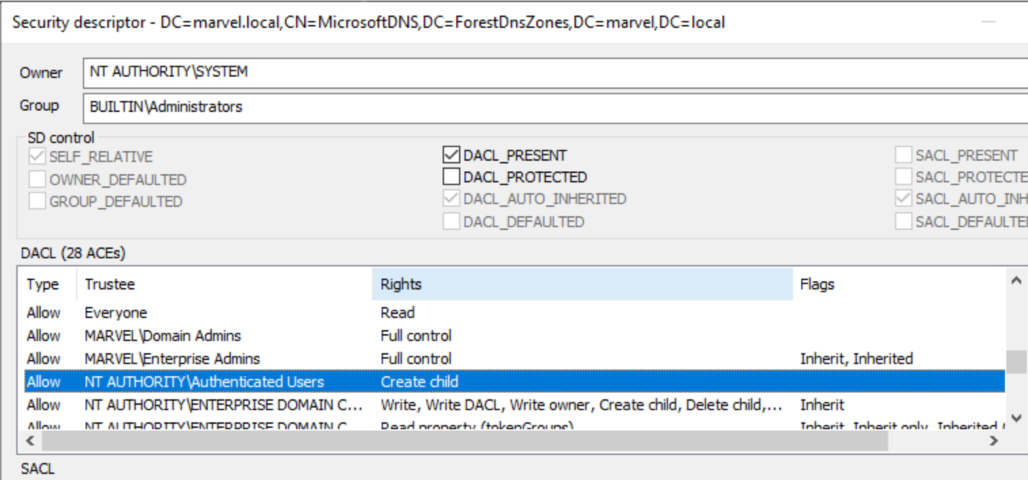
Kevin Robertson: Powermad
Takes advantage of default user rights to create DNS records (dnsNodes in AD)
*/WPAD/tombstoned computers
Redirect traffic to attacker machine
Responder… but more likely to work!
Notes:
This all works mostly because Addie and Dennis are joined at the hip.
And most importantly, because by default any Authenticated User can create those dnsNodes!
This is required by default because hosts (domain computers is part of authenticated users) need to be able to create (and update) their DNS records.

Slide 34

Kevin Robertson: Powermadam, I’m Adam
Default user rights also allow creating Zone Scope Containers.
…and Zone Scopes
…and dnsNodes
New-ADIDNSZoneScope
Notes:
I covered that, by default, any AuthUser can create any dnsNode (that doesn’t already exist).
When digging into the AD Schema around ADIDNS we noticed that any Auth User can also create a dnsZoneScopeContainer and that within that Zone Scope Container AuthUsers could create dnsZoneScopes. Zone Scopes are one of the many DNS features that were added with Windows Server 2016.
New-ADIDNSZoneScope

Slide 35
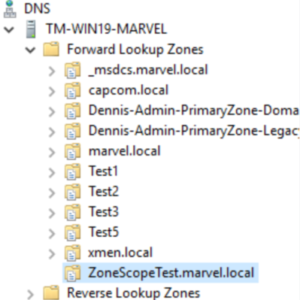
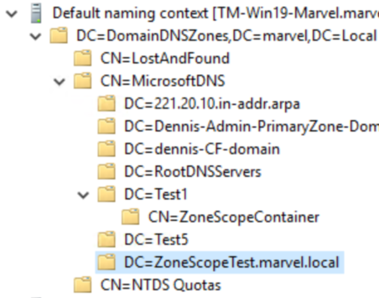
Kevin Robertson: Powermad
Default user rights also allow creating Zone Scope Containers.
…and Zone Scopes
…and dnsNodes
New-ADIDNSZoneScope
BEFORE
Notes:
I modified a Powermad function to create a dnsZoneScopeContainer and dnsZoneScopes beneath it.
dnsZoneScopes and the containers that hold them replicate along with the parent dnsZone they are a child of, whether that's a ForestDNSZone, DomainDNSZone, or LegacyZone.
On the left is DNS Server Manager GUI and the right ADSI edit.
dnsZoneScopes are generally intended to interact with DNS Query Policies and DNS Resolution Policies (also introduced in Windows Server 2016).

Slide 36
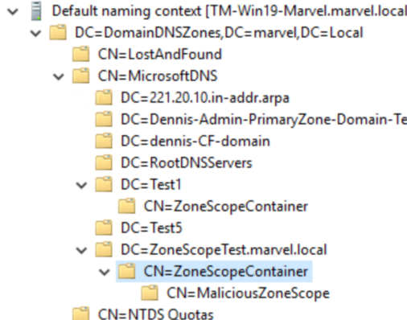
Kevin Robertson: Powermad
Default user rights also allow creating Zone Scope Containers.
…and Zone Scopes
…and dnsNodes
New-ADIDNSZoneScope
AFTER
Notes:
After New-ADIDNSZoneScope, DNS Manager looks the same, but ADSI edit…
This appears to be a bit of a dead-end for what AuthUsers can do with dnsZoneScopes...
But maybe the ability of any authenticated user to create these dnsZoneScopes with the ability to create any dnsNodes under them could be abused in other ways, like an internal C2 channel? Or, depending on the environment there may be other paths.
Although, an attacker might not need this for a C2 channel when you can use DNS for the C2 traffic: DNS Peer-to-Peer Command and Control with ADIDNS | Shenanigans Labs
Notes: DNS Policies are applied in the registry of individual DNS instead of being stored and replicated in AD. This restriction makes it so even DnsAdmins can't create a DNS Policy. These require Administrator (or SYSTEM/TrustedInstaller) rights on the DNS server to create, which in this case is going to be a Domain Controller.

Slide 37
Dirk-jan Mollema & Elad Shamir: DACL Abuse
”Relaying” Kerberos
Resource-Based Constrained Delegation (RBCD)
ms-DS-Additional-Dns-Host-Name attribute
ms-DS-AllowedToActOnBehalfOfOtherIdentity
Vulnerable DACLs on dnsNodes & dnsZones
Notes:
Research from these 2 shows possibilities for “relaying” Kerberos unconstrained delegation and abusing Resource-Based Constrained Delegation (RBCD).
Tying in with Kevin’s research & Powermad tool and some tricky DACL issues on computer objects, especially the Additional-Dns-Host-Name & AllowedToActOnBehalfOfOtherIdentity attributes (SPN too!) this research shows ways that ADIDNS and Kerberos interact and can be abused.
When combined with vulnerable DACLs on DNS objects stored in AD this can open up attack avenues many defenders are not yet considering. Different types of dnsZones have different base DACLs, and dnsNodes get different permissions depending on where, how, and who creates them. If dnsNodes/Records are created a certain way any Authenticated User will have GenericWrite on the record, for example.
(Reference links will be provided at the end of the slide deck)
References:
What about creating DNS entries for RBCD abuses like Wagging the Dog and krbrelayx
https://dirkjanm.io/krbrelayx-unconstrained-delegation-abuse-toolkit/
https://github.com/dirkjanm/krbrelayx/
https://dirkjanm.io/relaying-kerberos-over-dns-with-krbrelayx-and-mitm6/
Alternate-DNSHostname attribute
https://dirkjanm.io/abusing-forgotten-permissions-on-precreated-computer-objects-in-active-directory/
https://learn.microsoft.com/en-us/windows/win32/adschema/r-dns-host-name-attributes
https://learn.microsoft.com/en-us/windows/win32/adschema/r-domain-other-parameters

Slide 38
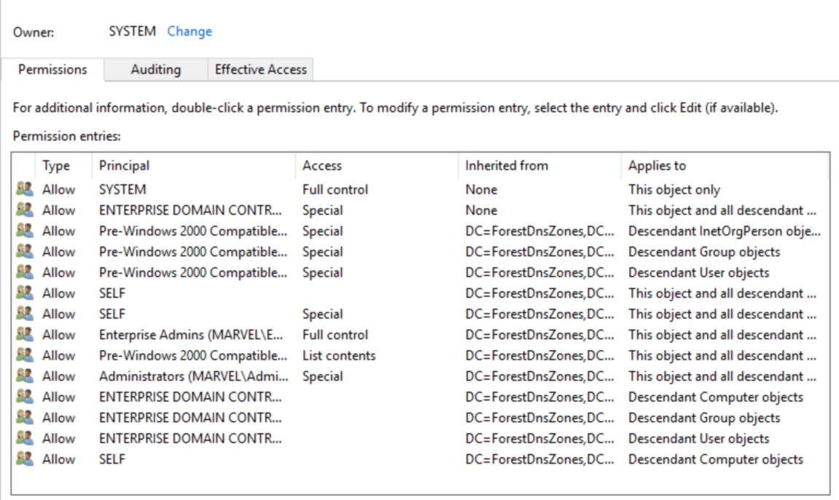
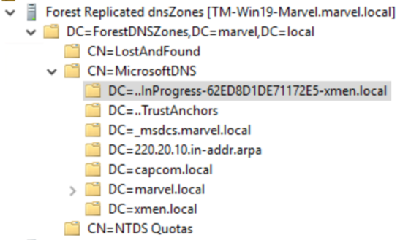
Forest Zones
Notes:
There are 4 ways to store dnsZones: Forest, Domain, Legacy, and files. We’ll skip files as they’re not replicated or really AD integrated.
The screenshot on the left shows what each dnsZone might look like in ADSI edit and the right shows the DACL on that CN=MicrosoftDNS container.
ForestDNSZones are stored in the DC=ForestDNSZones partition and replicated to all DCs in the AD Forest.
They have the strictest DACL, not even granting DnsAdmins rights.
_msdcs Subdomain for Server2003+ will be a ForestDNSZone. In modern AD this is the zone every client queries to locate DCs, ldap endpoints, KDCs, etc.
And Yes, even in my lab, DNS is broken.

Slide 39
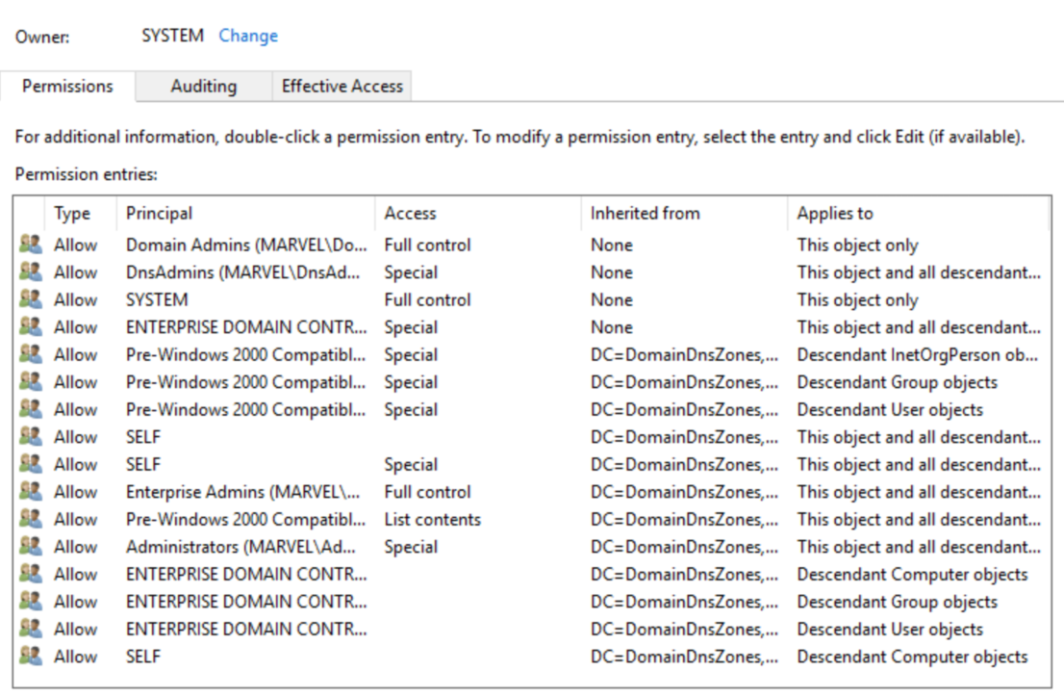
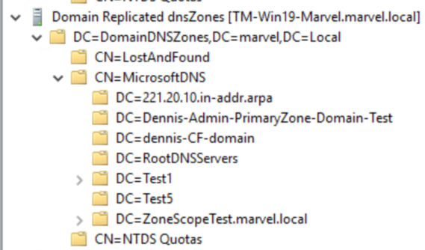


Domain Zones
Notes:
DomainDNSZones are also stored in a separate AD partition. They replicate to all DCs in the domain (not forest).
The DACL is still fairly strict but adds Domain Admins with Full Control and DnsAdmins with (almost) Full Control that inherits down.
On average, I’d imagine most ADI DNS zones would be DomainDNSZones in practice.

Slide 40
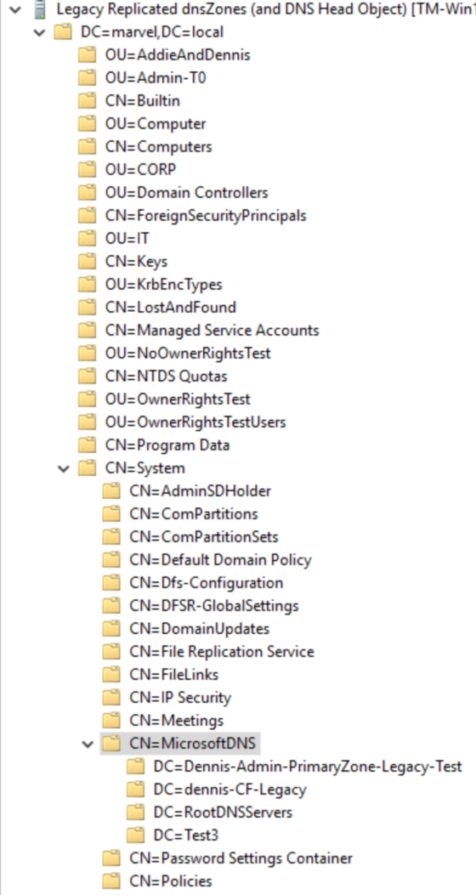
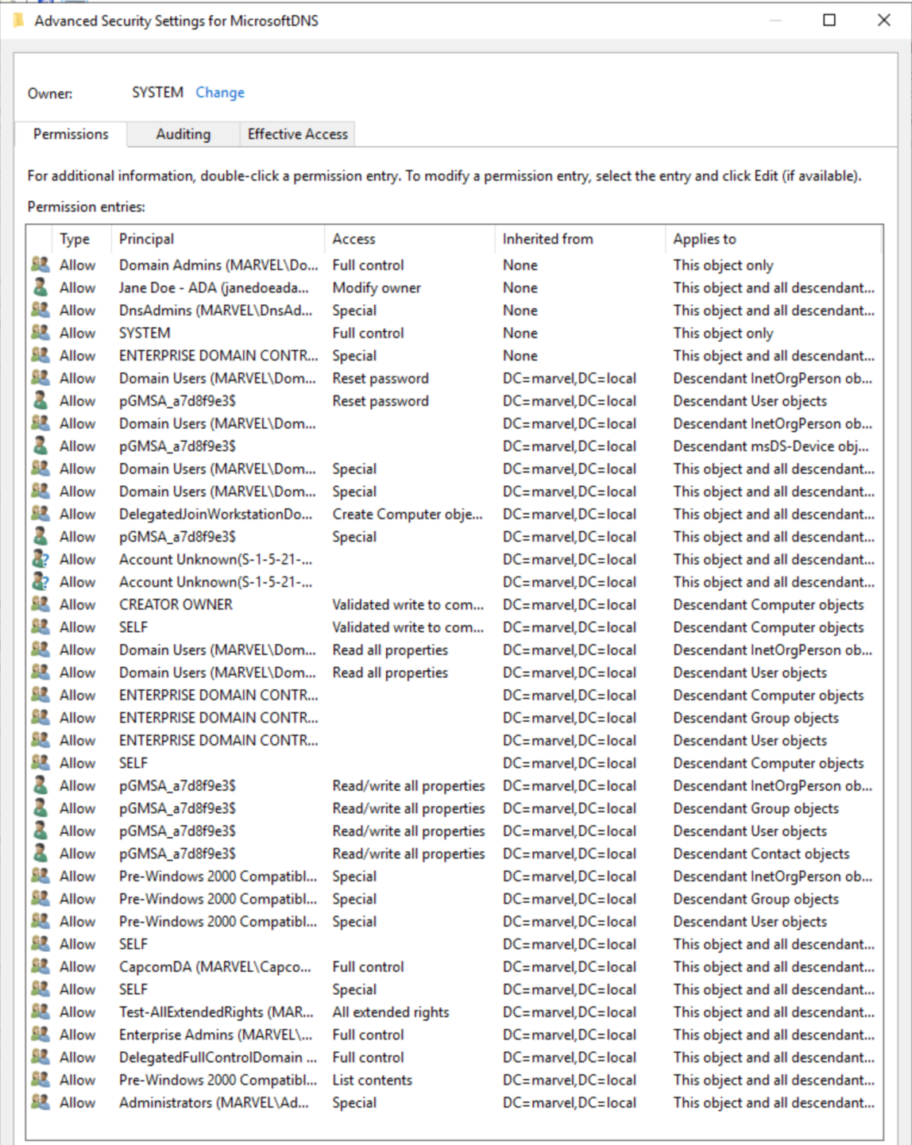

Legacy Zones & DNS Head
Notes:
CN=MicrosoftDNS,CN=System object is what I call the DNS Head object for all ADI DNS DNS hosts.
Any dnsZones stored in the legacy (Windows 2000 partition) will also be stored under this container and inherit permissions from Domain root.
References:
RootDNSServers aka Root Hints is also stored in the DNS Head object…
DnsAdmins Privesc in AD: https://medium.com/techzap/dns-admin-privesc-in-active-directory-ad-windows-ecc7ed5a21a2
Why DnsAdmins Privesc still working?: https://phackt.com/dnsadmins-group-exploitation-write-permissions
DnsAdmins Group Mitigations: https://phackt.com/dnsadmins-group-mitigation

Slide 41
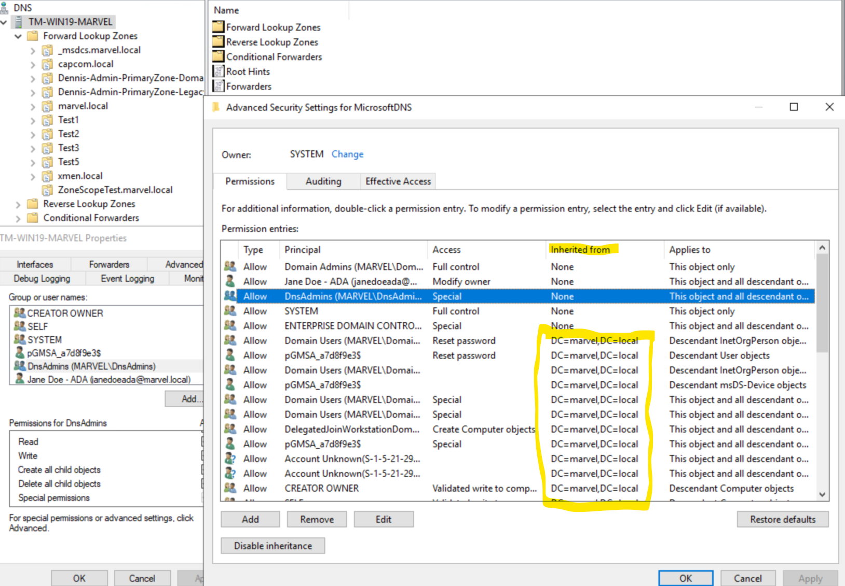
Legacy Zones & DNS Head
Notes:
The DNS Head object inherits permissions from Domain root, which can sometimes be atrocious.
By DNS Head object, I mean this corresponds with what you’d see if you look at the properties of a DNS Server Host in DNS Server Manager snap-in.
The permissions inherited from Domain Root are awful here, but I’ve seen worse.
Review: ForestDNSZones replicate forest-wide and have the strictest permissions. DomainDNSZones replicate domain-wide and have the next strictest permissions. Legacy dnsZones replicate domain-wide and have the worst permissions model.
One of the Legacy dnsZones could even be a GlobalNames zone to support single-label names, like those used in Intranet sites.
RootDNSServers aka Root Hints is also stored in the DNS Head object...
References:
DnsAdmins Privesc in AD: https://medium.com/techzap/dns-admin-privesc-in-active-directory-ad-windows-ecc7ed5a21a2
Why DnsAdmins Privesc still working?: https://phackt.com/dnsadmins-group-exploitation-write-permissions
DnsAdmins Group Mitigations: https://phackt.com/dnsadmins-group-mitigation
GlobalNames: The Frozen Geek: Configuring and Managing GlobalNames Zones

Slide 42
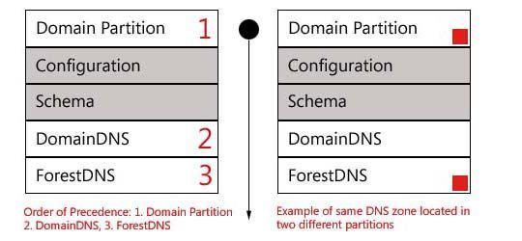

Zone Order of Precedence
Notes:
The DomainDNS and ForestDNS partitions were added in Windows Server 2003. This helped with AD replication as bandwidth was sparse back then.
But it also meant that it’s possible to have multiple copies of the same DNS zone, accidentally (or maybe even on purpose).
There is an Order of Precedence here that favors the DNSZone closest to that specific DNS Server.
If there’s 3 zones with the name “contoso.com”, each in their own partition, the one in the legacy Domain Partition will take priority and be the dnsRecords returned to clients.
References:
Am I Seeing Double? The case of "Multiple copies of the same DNS zone" - Microsoft Community Hub
Set-DnsServerGlobalNameZone (DnsServer) | Microsoft Learn

Slide 43
Shay Ber: DnsAdmins
(Were) able to replace DLLs on DNS Servers aka DCs in most environments
Reported in 2017, not resolved until 2021! (and then only Server 2012+)
Safe now…?
Not protected by SDProp+AdminSDHolder
Many paths to attack
Notes:
The DLL replacement issue is resolved in CVE-2021-40469 (patched in Server 2012+)
dnscmd.exe /config /serverlevelplugindll \\path\to\dll
This was publicly known from May 2017 and remained unpatched until November 2021
However, DnsAdmins still more powerful than expected and not protected AdminSDHolder
And sometimes, Microsoft might even recommend giving DnsAdmins more permissions instead of less: https://learn.microsoft.com/en-US/troubleshoot/windows-server/networking/record-cannot-deleted-access-denied
References:
Feature, not bug: DNSAdmin to DC Compromise in one line: https://medium.com/@esnesenon/feature-not-bug-dnsadmin-to-dc-compromise-in-one-line-a0f779b8dc83
Abusing DnsAdmins privilege for escalation in AD: http://www.labofapenetrationtester.com/2017/05/abusing-dnsadmins-privilege-for-escalation-in-active-directory.html
CVE-2021-40469: https://msrc.microsoft.com/update-guide/vulnerability/CVE-2021-40469
DnsAdmins to SYSTEM Walkthrough: https://github.com/blackc03r/OSCP-Cheatsheets/blob/master/offensive-security-experiments/active-directory-kerberos-abuse/from-dnsadmins-to-system-to-domain-compromise.md
From DnsAdmins to Domain Admin: https://adsecurity.org/?p=4064
DnsAdmins Revisited: https://www.semperis.com/blog/dnsadmins-revisited/
Micropatch: https://blog.0patch.com/2021/11/micropatch-for-remote-code-execution-by.html
DnsAdmins Privesc in AD: https://medium.com/techzap/dns-admin-privesc-in-active-directory-ad-windows-ecc7ed5a21a2
Why DnsAdmins Privesc still working?: https://phackt.com/dnsadmins-group-exploitation-write-permissions
DnsAdmins Group Mitigations: https://phackt.com/dnsadmins-group-mitigation

Slide 44
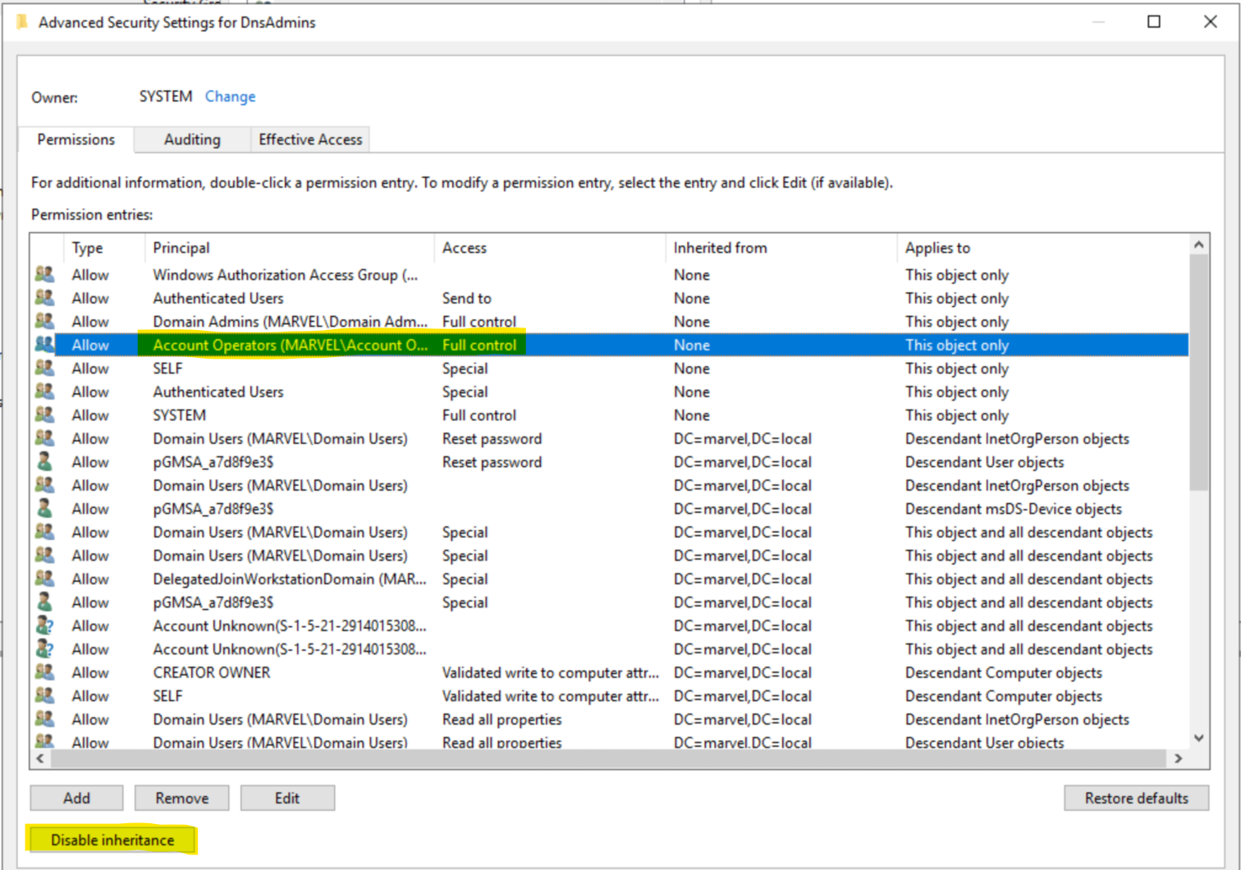
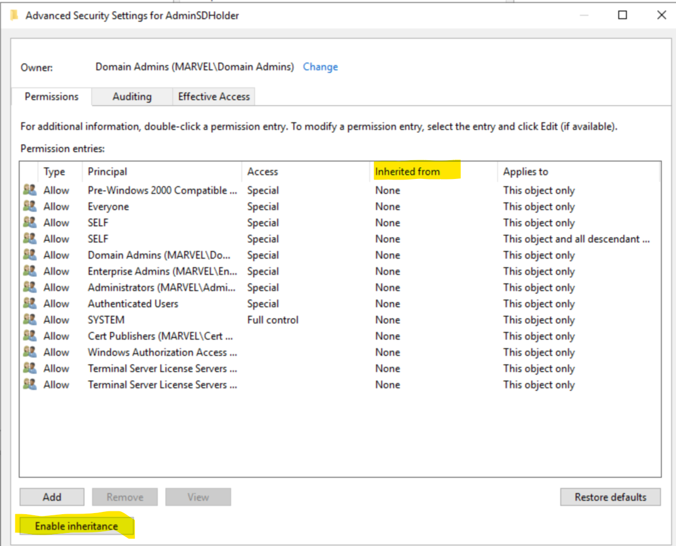
Shay Ber: DnsAdmins
Able to replace DLLs on DNS Servers aka DCs in most environments
Reported in 2017, not resolved until 2021! (and then only Server 2012+)
Safe now…?
Not protected by SDProp+AdminSDHolder
Many paths to attack
Notes:
On the left is the DACL for DnsAdmins group. It has explicit ACEs, including allowing Account Operators full control. Inheritance is enabled.
On the right is the DACL for AdminSDHolder, which is the DACL that gets “stamped” on Protected Objects. It’s a strict DACL with inheritance disabled.
This all means that there are often paths in environments from low-privileged users to DnsAdmin:
Domain Root => DnsAdmins
Account Operators => DnsAdmins
Users Container permissions => DnsAdmins
It’s rare to find an environment without paths that lead from standard user to DnsAdmins.

Slide 45
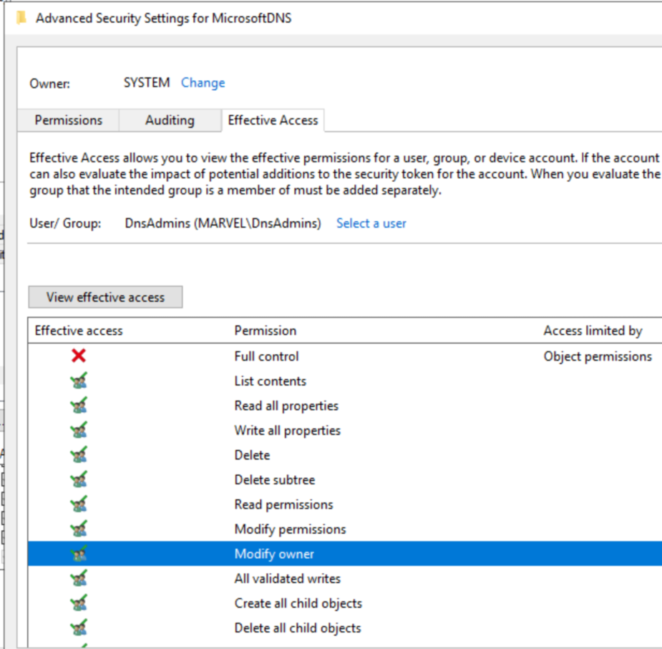
Shay Ber: DnsAdmins
Able to replace DLLs on DNS Servers aka DCs in most environments
Reported in 2017, not resolved until 2021! (and then only Server 2012+)
Safe now…?
Not protected by SDProp+AdminSDHolder
Many paths to attack
Notes:
Quick reminder: DnsAdmins has an explicit ACE on the MicrosoftDNS container for DomainDNSZones and Legacy zones. They don’t have Full control, but they do have Modify permissions & Modify owner.
A DnsAdmin could grant permissions to any arbitrary attacker-controlled security principal and cause them to inherit down to legacy zones or Root Hints.
Also, If you are, or can become, the Owner of an object in AD, by default this is even more powerful than Full control(GenericAll).
Jake: Go to the Trimarc Content Hub for more details in Jim's whitepaper Owner or Pwned.

Slide 46
Something New
Addie
Dennis
Notes:
And now for something completely different..
I’ll be talking about some newer things I happened upon while exploring ADI DNS.

Slide 47

Evil Sinkhole
Create new DNS Zones
DomainDNSZones
Legacy Zones
Local Zones (not replicated)
Create new Conditional Forwarders
Send traffic to:
Attacker-controlled DNS
Attacker-controlled device
Nothing
Notes:
Defenders sometimes utilize DNS sinkholes to help prevent access to malicious or unwanted domains. What if an attacker could sinkhole traffic that might get them caught?
Evil Sinkholes
DnsAdmins can…

Slide 48
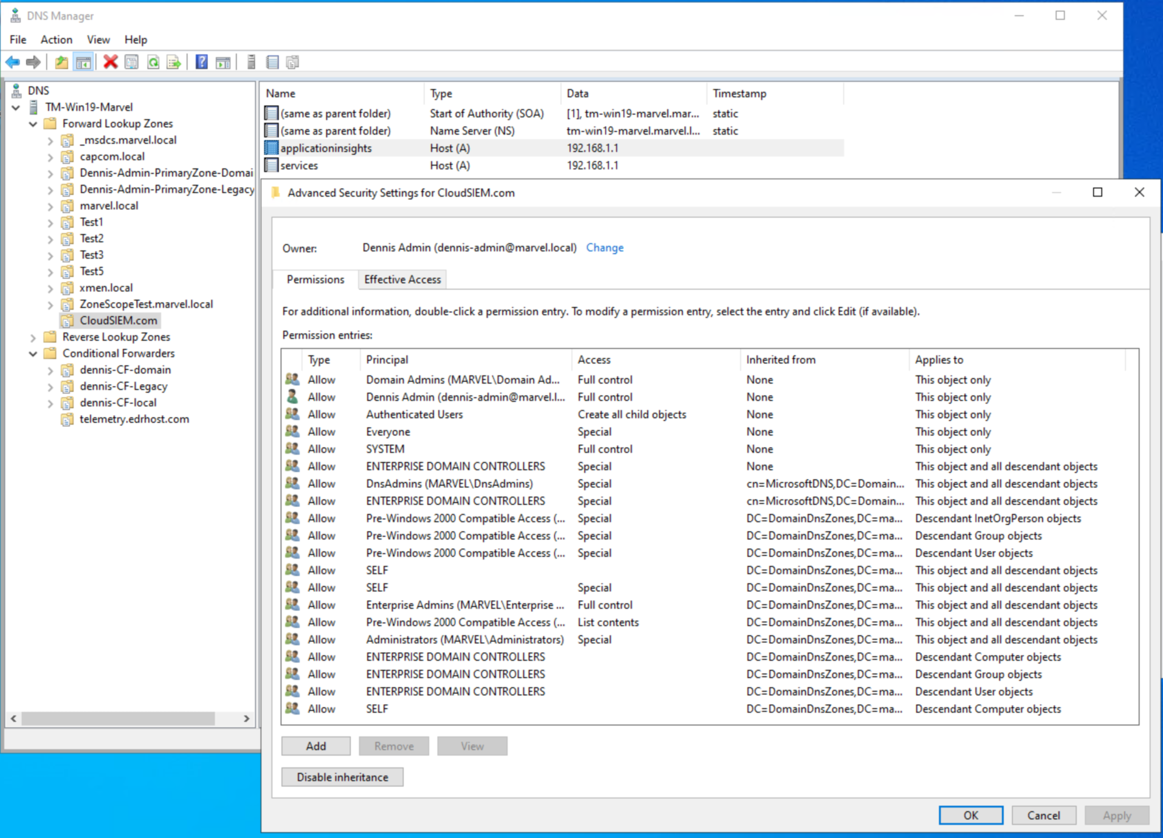
Evil Sinkhole
Create new DNS Zones
DomainDNSZones
Legacy Zones
Local Zones (not replicated)
Create new Conditional Forwarders
Send traffic to:
Attacker-controlled DNS
Attacker-controlled device
Nothing
Notes:
DnsAdmins can:
Create new DomainDNSZones, Legacy (Win2k) dnsZones, and Local Zones (.dns file, non-replicating)
DNS zones for an external domain (but hosted internally) mirrors the concept of split-brain DNS. The local DNS server thinks it’s authoritative and it won’t recurse.

Slide 49
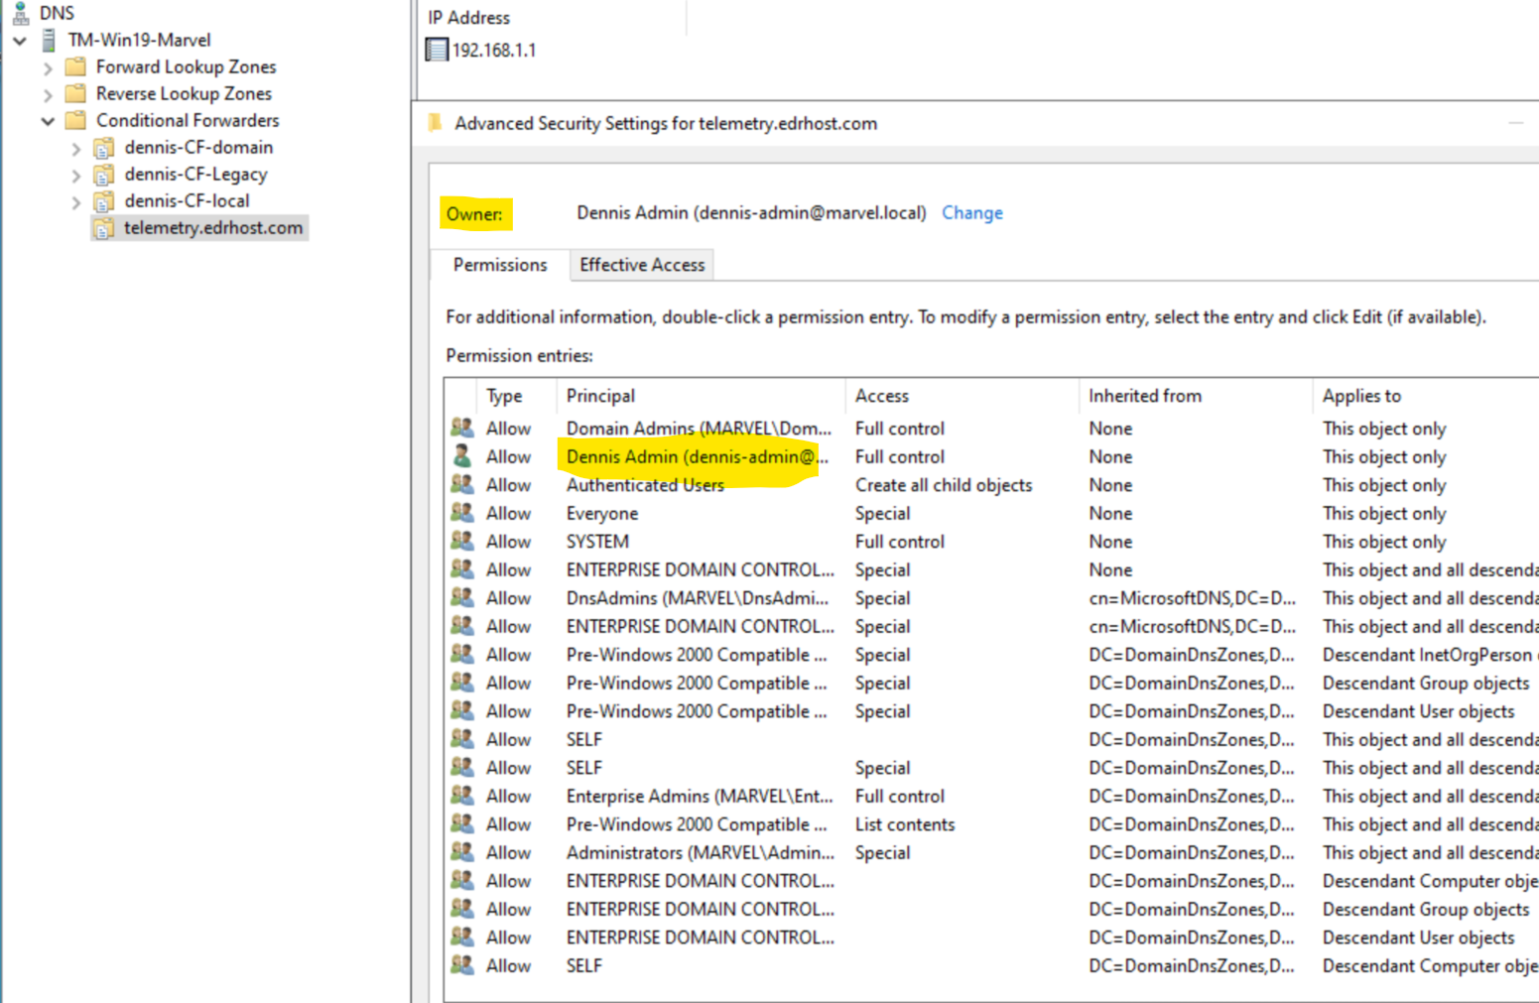
Evil Sinkhole
Create new DNS Zones
DomainDNSZones
Legacy Zones
Local Zones (not replicated)
Create new Conditional Forwarders
Send traffic to:
Attacker-controlled DNS
Attacker-controlled device
Nothing
Notes:
DnsAdmins can also create:
Conditional Forwarders
Attacker-controlled DNS
Attacker-controlled device
Nothing (if no answer, fail)
Conditional Forwarders create a rule that forwards DNS queries for specific namespaces to explicitly defined DNS servers for lookup.
So how could an attacker abuse this?

Slide 50
Evil Sinkhole Uses
Blind your EDR
Blind your SIEM
Redirect management traffic
Redirect patching traffic
Redirect AV signatures
Redirect Trusted Sites or Intranet Zone?
Fairly noisy & wide-ranging
Notes:
These features could be used to cause name resolution to fail or return bad information. But it's broadly applied and noisy.
What could an attacker sinkhole?
EDR that designed by folks not smart enough to build an IP failsafe in
SIEM hostnames
Update hosts for patches and AV signatures
Redirect traffic in Trusted Sites or Intranet zones?
Is there a quieter way?

Slide 51
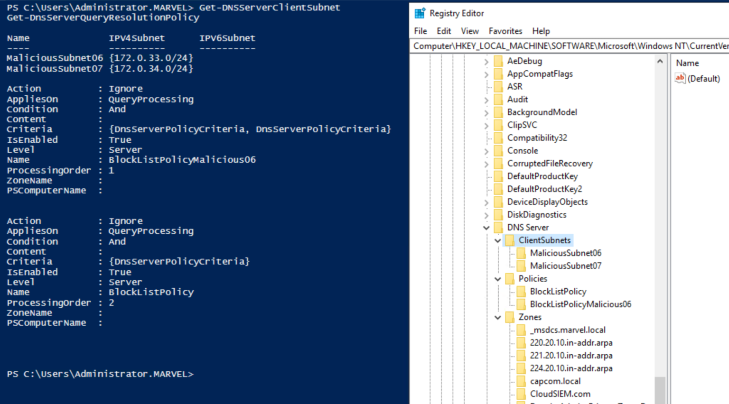
Policy Poisoning
Introduced in Windows Server 2016
2 types: Query Resolution & Recursion
Don’t show up in DNS GUI
Stored in the registry of the DNS server
Similar use cases to Evil Sinkhole… but slightly more evil by being more sneaky
Notes:
DNS Policies were introduced in Windows Server 2016. They don't show up in a GUI. Primary interface is through PowerShell in RSAT tools.
In a post-compromise scenario, DNS Policies could be created to filter DNS queries, redirect traffic ala split-brain DNS, and perform targeted poisoning. This could be combined with dnsZoneScopes to replicate the poisoning across multiple DNS servers.
DNS Policies not widely known and have a wide range of functions that can be used for good or bad.
Don't show in DNS Manager. Not stored in AD. On each DNS server in HKLM\SOFTWARE\Microsoft\Windows NT\CurrentVersion\DNS Server, which is locked down to Administrators for the Domain, SYSTEM, and TrustedInstaller. An attacker with Administrators rights could perform surgically targeted DNS manipulation to block or redirect traffic.
Maybe an attacker would just get SYSTEM or TrustedInstaller on the DNS Server? Well, yeah that's a Domain Controller, so as I said, this is post-compromise.
Unless, if the AD environment is poorly configured enough? Overly permissive DACLs at the Domain root could allow for escalation. Even more likely, unprivileged users having modify rights to a GPO linked to the Domain root or Domain Controllers OU could lead to the ability to execute code on a DC as SYSTEM or make registry modifications that allow creation of poisoned DNS policies that defenders might not be looking for.
And to be clear, DNS Policies in Server 2016+ aren’t just for malicious traffic. This is now the Microsoft-recommended way to implement split-brain DNS. It’s also great for filtering out queries for known malicious sites if you don’t have a forwarder that will do that for you. Sometimes these new(ish) features fly under the radar.
Add-DnsServerClientSubnet -name CompromisedHost -ipv4subnet 10.10.10.127/32
Add-DnsServerQueryResolutionPolicy -Name "Disallow_AM" -Action IGNORE -ClientSubnet "EQ,CompromisedHost" –FQDN "EQ,*.applicationinsights.azure.com,*.services.visualstudio.com,*.applicationinsights.microsoft.com," -PassThru
References:
What's New in DNS Server: https://learn.microsoft.com/en-us/windows-server/networking/dns/what-s-new-in-dns-server
DNS Policy Scenario Guide: https://learn.microsoft.com/en-us/windows-server/networking/dns/deploy/dns-policy-scenario-guide
Split-Brain DNS Deployment: https://learn.microsoft.com/en-us/windows-server/networking/dns/deploy/split-brain-dns-deployment
DnsServer PowerShell: https://learn.microsoft.com/en-us/powershell/module/dnsserver/?view=windowsserver2022-ps

Slide 52

Dangling SPNs
Kerberos relies on Hostnames
Service Principal Names (SPNs) are often added, rarely removed
SPN form: SERVICE/HOST
Find accounts with SPNs pointing to hosts that no longer exist
Scan AD for SPNs with hosts that no longer exist
Create new computer account and/or dnsNode for missing host
Coerce authentication
Profit?
Notes:
How many of you have created an SPN? How many have ever deleted an SPN?
This is more of an experiment in process or a theory than a working concept. While I think I know Kerberos more than some folks, I still learn every day how much I don’t know it.
Just as ADI DNS relies on Active Directory to function, many parts of AD rely on DNS to function. Things like Kerberos.
More specifically, Kerberos relies on User Principal Names (UPN) and Service Principal Names (SPN), which in turn rely on DNS.
There's a few blog posts that inspired this idea:
Dirk-jan Mollema: https://dirkjanm.io/krbrelayx-unconstrained-delegation-abuse-toolkit/
Kevin Robertson: https://www.netspi.com/blog/technical/network-penetration-testing/machineaccountquota-is-useful-sometimes/
Charlie Clark: https://exploit.ph/user-constrained-delegation.html
Elad Shamir: https://www.semperis.com/blog/spn-jacking-an-edge-case-in-writespn-abuse/ Elad coined these Ghost SPNs, and that’s a great name, but I like Dangling SPNs better as it’s not so serious. ☺

Slide 53
Dangling SPNs
Kerberos relies on Hostnames
Service Principal Names (SPNs) are often added, rarely removed
SPN form: SERVICE/HOST
Find accounts with SPNs pointing to hosts that no longer exist
Scan AD for SPNs with hosts that no longer exist
Create new computer account and/or dnsNode for missing host
Coerce authentication
Profit?
Notes:
Most of these blog posts focus on either obtaining a way to add an SPN to an account or create an account with an SPN. But what if we can compromise an account that’s already configured with multiple SPNs or an account with an unused SPN? SPNs that were always added, but never cleaned up. Could we use one of these Dangling SPNs to escalate privileges in the environment by also abusing DNS?
From the Unconstrained Delegation side this would focus on coercing traffic to an attacker-controlled machine. Similar concepts to this have been demonstrated by Charlie Clark.
From the Constrained/Magic Delegation side this would attempt to route traffic to higher value services via DNS poisoning and ms-DS-AlternateDNS-Hostnames.
<Note: Indeed, Jim couldn't actually make this work in practice(yet), but it's a great theory and these SPNs should be cleaned up anyways> It probably isn’t working because of DNS :P
Bonus:
Also, it's possible to abuse "Secure dynamic updates" DNS Operation: https://dirkjanm.io/relaying-kerberos-over-dns-with-krbrelayx-and-mitm6/
References:
MachineAccountQuote is Useful Sometimes: https://www.netspi.com/blog/technical/network-penetration-testing/machineaccountquota-is-useful-sometimes/
DC Print Server + Unconstrained Delegation = Pwned AD Forest: https://adsecurity.org/?p=4056

Slide 54
Something Borrowed
Addie
Dennis
Notes:
And now that I’ve brought Something Old and Something New to AD & DNS’s 23rd anniversary celebration, you may be thinking about (or already have) outsourcing your Active Directory DNS functions to a 3rd party service whether that’s BIND or some hosted DNS, DHCP, and IPAM (DDI) solution. But as critical to AD as DNS is are you sure you want to delegate that Tier 0(control plane) service away from a Tier 0 DC and give full control of DNS (and by proxy AD) to your networking team or a 3rd party SaaS provider?
Instead, let’s have Jake tell us about Something Borrowed.

Slide 55

Defenses: Configuration
Disable LLMNR/NBNS/mDNS
Create wildcard (*) record
Create WPAD record
Empty DnsAdmins
Eliminate Legacy Zones
Audit Global Query Block List (GQBL)
Notes:
LLMNR etc.: not exactly DNS, but disable these protocols in your network. They are not required in most modern networks.
Wildcard:
Properly configured wildcard record causes all queries for unknown names to fail in DNS.
Single- domain forest with previous protocols enabled, use an A record.
Forest with multiple domains configured in DNSSuffixSearchOrder, use a TXT record
or use of non-fully qualified queries may fail. (But really, just use FQDN for everything)
WPAD: Web Proxy Auto Detection. MAY be necessary in your network, but if it’s not, create your own record.
We’ve shown how dangerous DnsAdmins is
Windows 2000 was EOL over a decade a go.
GQBL: a per-DNS list of hosts which DNS simply will not respond to. By default includes wpad and isatap, both of which are well-known records

Slide 56
Defenses: Auditing
Use DHCP Dynamic Update service account
Audit DNS DACLs
Audit DNS Zones
Audit Zone Scopes
Audit Policies
Audit Dangling SPNs
Notes:
DHCP Dynamic Update service account:
Audit DNS DACLs:
domain root
domain head object
Zones
Zone scopes
dnsNodes
DNS Zones: DNS console
Zone Scopes: Powershell, ADSI Edit, or IPAM
Policies: Powershell, Registry
Dangling SPNs: If you hate yourself, ADUC, ADSI Edit. Otherwise, powershell

Slide 57
Something Blue
Addie
Dennis

Slide 58
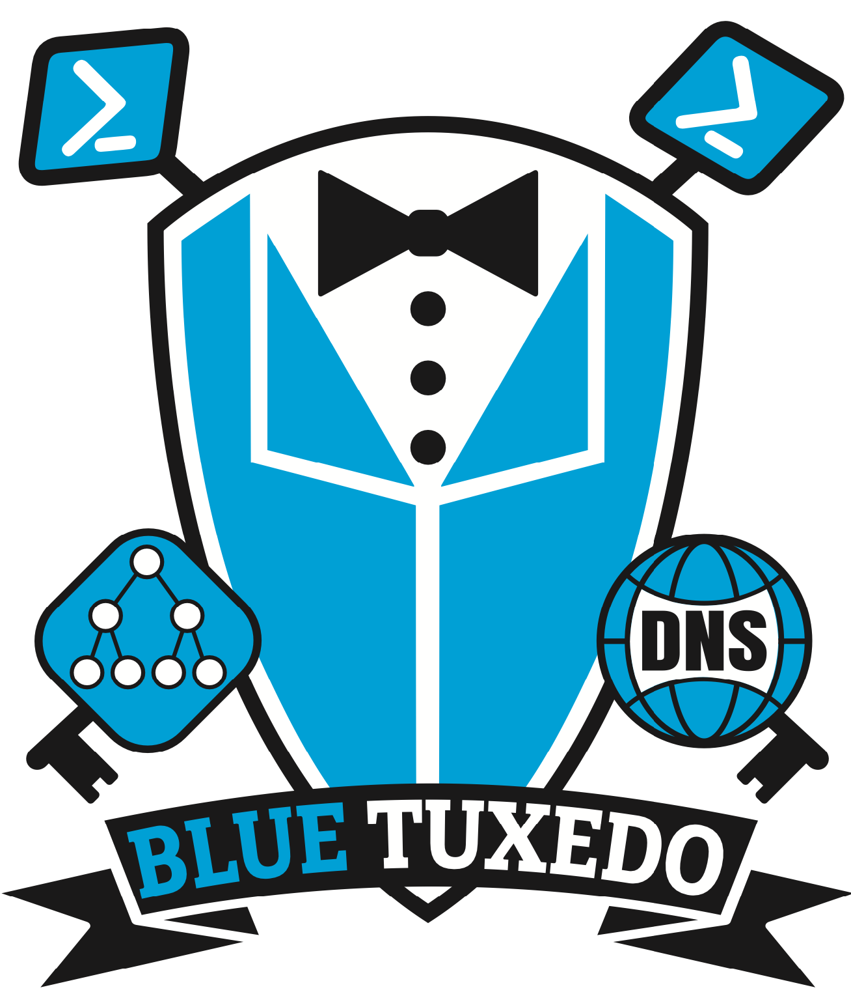
Addie
Dennis

Slide 59

BlueTuxedo
Dangling SPNs
DnsAdmins Membership
Wildcard Record
WPAD Record
Global Query Block List (GQBL)
DHCP Dynamic Update service account
Weird DACLs
Tombstoned DNS Records
Conditional Forwarder Auditing
Zone & Zone Scope Auditing
Forwarder Configuration
Socket Pool Configuration
Notes:
Dangling SPNs
DnsAdmins Membership: Check to make sure DnsAdmins is blank. If it's not blank, make sure the members are in other groups which get SDProp+AdminSDHolder protections.
Wildcard & WPAD Records:
Check if records exists:
If YES, check type
TXT = Good
A = Suspicious, user should investigate
NS = BAD, offer to delete and recreate as TXT
Other = Probably Invalid
If NO: Offer to create as TXT
Global Query Block List (GQBL): ensure it’s enabled and contains the default entries.
DHCP Dynamic Update service account: Ensure this is configured.
Weird DACLs: DNS attack tools create ACLs with signatures. Will check for these!
Tombstoned DNS Records: List and offer to delete.
Zone & Zone Scope Auditing: List these. Highlight the Zone Scopes.
Conditional Forwarder Auditing: List these.
Forwarder Configuration: Root hints are slower and iterative
Check if Forwarders exist:
NO: Suggest secure forwarders or ISP-provided forwarders
YES: List all w/FQDN
Socket Pool Configuration: Set to 2500 by default, max is 10000. Offer to set to max.

Slide 60
BlueTuxedo
Available now!
https://github.com/TrimarcJake/BlueTuxedo
Features to be added:
More remediations
Better ACE filtering
Better descriptions
Text-based User Interface
Always looking for contributors!
Notes:
Dangling SPNs
DnsAdmins Membership: Check to make sure DnsAdmins is blank. If it's not blank, make sure the members are in other groups which get SDProp+AdminSDHolder protections.
Wildcard & WPAD Records:
Check if records exists:
If YES, check type
TXT = Good
A = Suspicious, user should investigate
NS = BAD, offer to delete and recreate as TXT
Other = Probably Invalid
If NO: Offer to create as TXT
Global Query Block List (GQBL): ensure it’s enabled and contains the default entries.
DHCP Dynamic Update service account: Ensure this is configured.
Weird DACLs: DNS attack tools create ACLs with signatures. Will check for these!
Tombstoned DNS Records: List and offer to delete.
Zone & Zone Scope Auditing: List these. Highlight the Zone Scopes.
Conditional Forwarder Auditing: List these.
Forwarder Configuration: Root hints are slower and iterative
Check if Forwarders exist:
NO: Suggest secure forwarders or ISP-provided forwarders
YES: List all w/FQDN
Socket Pool Configuration: Set to 2500 by default, max is 10000. Offer to set to max.

Slide 61


Slide 62

Thank you!
Kevin Robertson
Shay Ber
Charlie Clark
Dirk-jan Mollema
Elad Shamir
WWHF
Trimarc
You
Notes:
Thank you to the researchers we learned from.
Wild West Hackin’ Fest for having us.
Trimarc for sponsoring and employing us.
And you for attending?

Slide 63


Questions?
It’s not DNS There’s no way it’s DNS It was DNS
Jim Sykora
@JimSycurity
Jake Hildreth
@horse@infosec.exchange
Jim
Jake
Notes:
It’s not DNS
There’s no way it’s DNS
It was DNS.

Slide 64
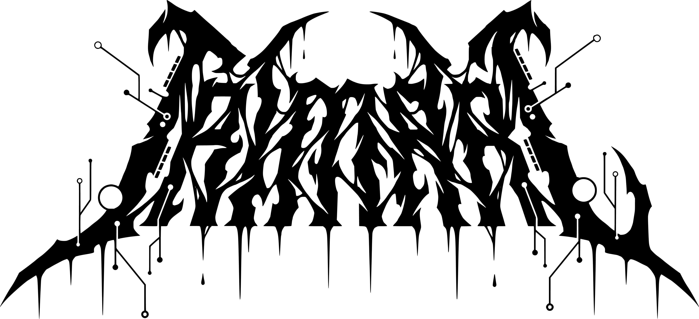
Resources
adsecurity.org/?p=4056
adsecurity.org/?p=4064
blog.0patch.com/2021/11/micropatch-for-remote-code-execution-by.html
dirkjanm.io/abusing-forgotten-permissions-on-precreated-computer-objects-in-active-directory/
dirkjanm.io/krbrelayx-unconstrained-delegation-abuse-toolkit/
dirkjanm.io/relaying-kerberos-over-dns-with-krbrelayx-and-mitm6/
exploit.ph/user-constrained-delegation.html
github.com/blackc03r/OSCP-Cheatsheets/blob/master/offensive-security-experiments/active-directory-kerberos-abuse/from-dnsadmins-to-system-to-domain-compromise.md
github.com/dirkjanm/krbrelayx/
github.com/Kevin-Robertson/Powermad
learn.microsoft.com/en-US/troubleshoot/windows-server/networking/record-cannot-deleted-access-denied
learn.microsoft.com/en-us/windows/win32/adschema/r-dns-host-name-attributes
learn.microsoft.com/en-us/windows/win32/adschema/r-domain-other-parameters
medium.com/@esnesenon/feature-not-bug-dnsadmin-to-dc-compromise-in-one-line-a0f779b8dc83
medium.com/techzap/dns-admin-privesc-in-active-directory-ad-windows-ecc7ed5a21a2
msrc.microsoft.com/update-guide/vulnerability/CVE-2021-40469
phackt.com/dnsadmins-group-exploitation-write-permissions
phackt.com/dnsadmins-group-mitigation
www.labofapenetrationtester.com/2017/05/abusing-dnsadmins-privilege-for-escalation-in-active-directory.html
www.netspi.com/blog/technical/network-penetration-testing/adidns-revisited/
www.netspi.com/blog/technical/network-penetration-testing/exploiting-adidns/
www.netspi.com/blog/technical/network-penetration-testing/machineaccountquota-is-useful-sometimes/
www.netspi.com/blog/technical/network-penetration-testing/machineaccountquota-is-useful-sometimes/
www.semperis.com/blog/dnsadmins-revisited/
www.semperis.com/blog/spn-jacking-an-edge-case-in-writespn-abuse/
www.trustwave.com/en-us/resources/blogs/spiderlabs-blog/introducing-responder-10/
Notes:
https://adsecurity.org/?p=4056
https://adsecurity.org/?p=4064
https://blog.0patch.com/2021/11/micropatch-for-remote-code-execution-by.html
https://dirkjanm.io/abusing-forgotten-permissions-on-precreated-computer-objects-in-active-directory/
https://dirkjanm.io/krbrelayx-unconstrained-delegation-abuse-toolkit/
https://dirkjanm.io/relaying-kerberos-over-dns-with-krbrelayx-and-mitm6/
https://exploit.ph/user-constrained-delegation.html
https://github.com/blackc03r/OSCP-Cheatsheets/blob/master/offensive-security-experiments/active-directory-kerberos-abuse/from-dnsadmins-to-system-to-domain-compromise.md
https://github.com/dirkjanm/krbrelayx/
https://github.com/Kevin-Robertson/Powermad
https://learn.microsoft.com/en-US/troubleshoot/windows-server/networking/record-cannot-deleted-access-denied
https://learn.microsoft.com/en-us/windows/win32/adschema/r-dns-host-name-attributes
https://learn.microsoft.com/en-us/windows/win32/adschema/r-domain-other-parameters
https://medium.com/@esnesenon/feature-not-bug-dnsadmin-to-dc-compromise-in-one-line-a0f779b8dc83
https://medium.com/techzap/dns-admin-privesc-in-active-directory-ad-windows-ecc7ed5a21a2
https://msrc.microsoft.com/update-guide/vulnerability/CVE-2021-40469
https://phackt.com/dnsadmins-group-exploitation-write-permissions
https://phackt.com/dnsadmins-group-mitigation
https://www.labofapenetrationtester.com/2017/05/abusing-dnsadmins-privilege-for-escalation-in-active-directory.html
https://www.netspi.com/blog/technical/network-penetration-testing/adidns-revisited/
https://www.netspi.com/blog/technical/network-penetration-testing/exploiting-adidns/
https://www.netspi.com/blog/technical/network-penetration-testing/machineaccountquota-is-useful-sometimes/
https://www.netspi.com/blog/technical/network-penetration-testing/machineaccountquota-is-useful-sometimes/
https://www.semperis.com/blog/dnsadmins-revisited/
https://www.semperis.com/blog/spn-jacking-an-edge-case-in-writespn-abuse/
https://www.trustwave.com/en-us/resources/blogs/spiderlabs-blog/introducing-responder-10/
https://shenaniganslabs.io/2020/04/14/Internal-DNS-C2.html
https://techcommunity.microsoft.com/t5/core-infrastructure-and-security/am-i-seeing-double-the-case-of-quot-multiple-copies-of-the-same/ba-p/255499
https://thefrozengeek.blogspot.com/2018/02/configuring-and-managing-globalnames.html

